Slide 1
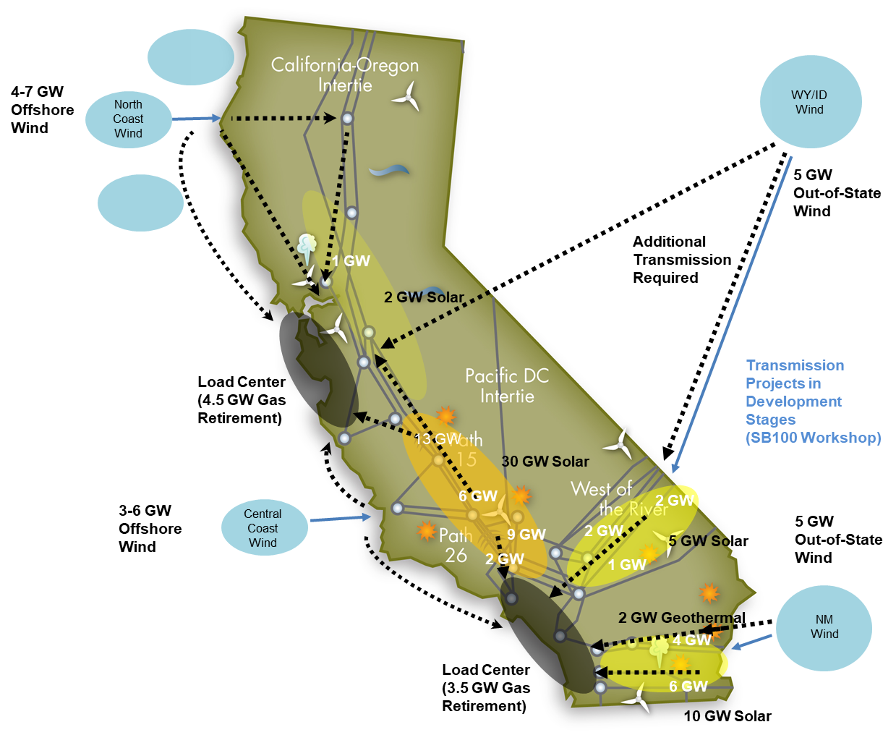
In addition to the annual 10-Year Plan, the CAISO’s recent 20-Year Outlook set out a long term architecture for in-state, offshore and out-of-state needs highlighting the need for interregional coordination and cooperation
The CAISO’s annual transmission plan addresses regional and local needs over 80% of California and part of Nevada
Based on resource needs coordinated with state agency planning
53 GW | Solar
22.2 GW | Wind
2.3 GW | Geothermal
37 GW | Battery
4 GW | Long-duration Storage
120 GW | Total resource and storage requirement
$30.5B | Estimated cost of transmission
Neil Millar WPTF 2022 08 12 CAISO Public

